Slide 1
Data Management Presentation
Aila Enos, Raj Bose, Emily Hart

Slide 2
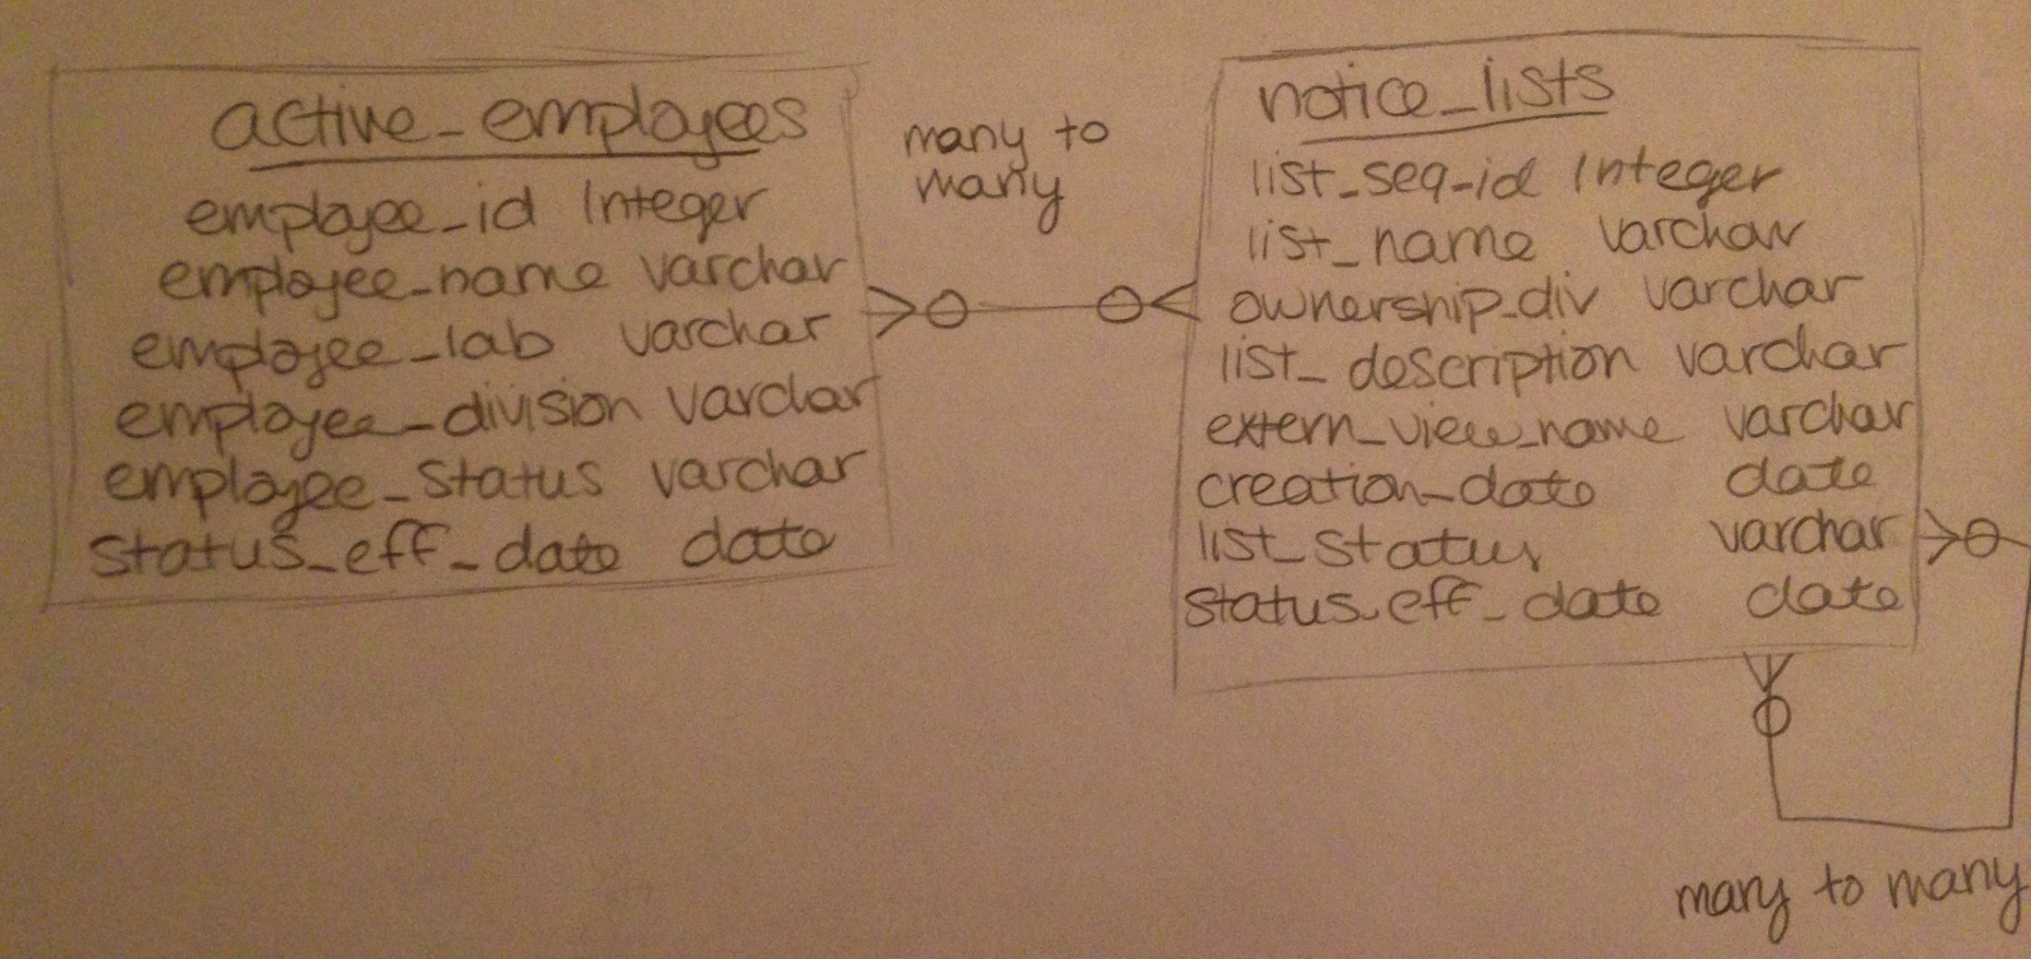
Conceptual Model

Slide 3
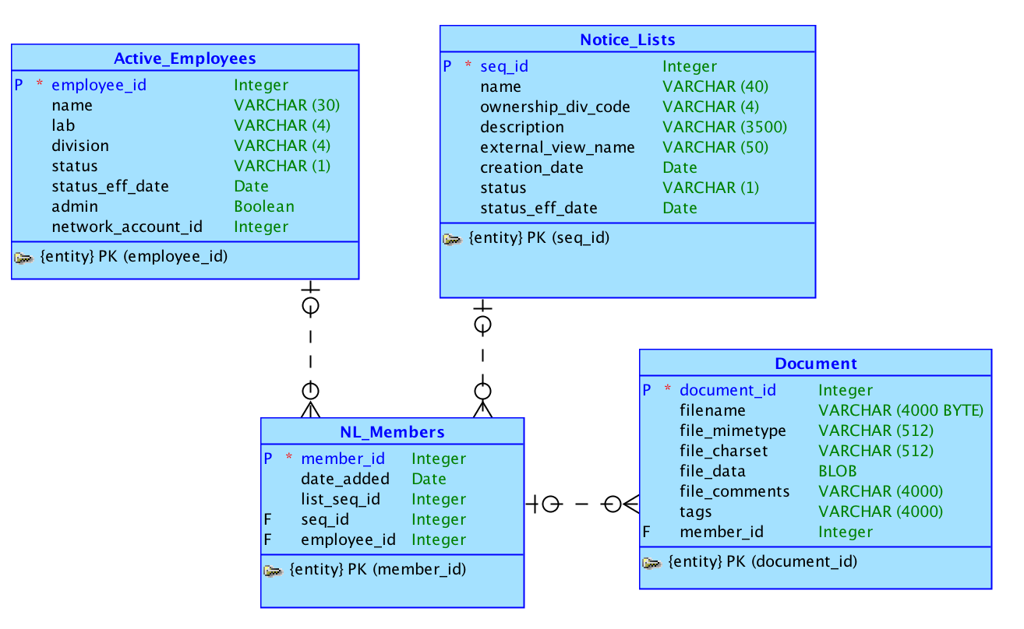
Logical Model

Slide 4
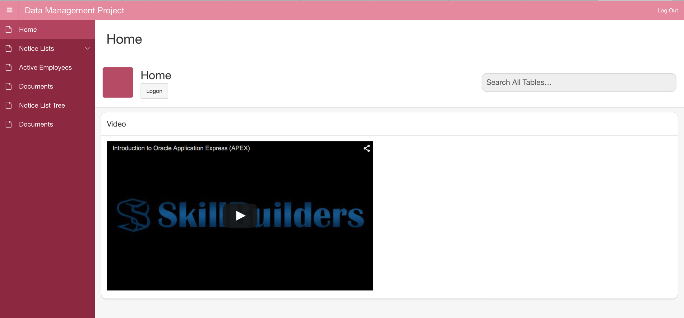
Home

Slide 5
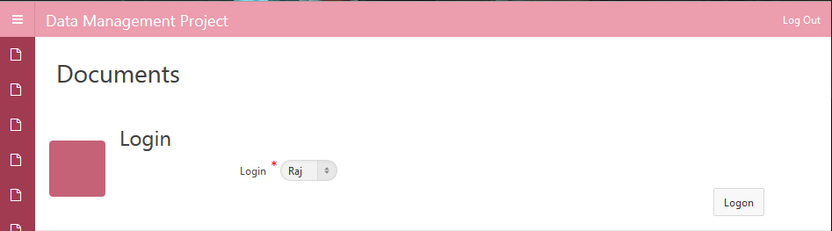
Login

Slide 6
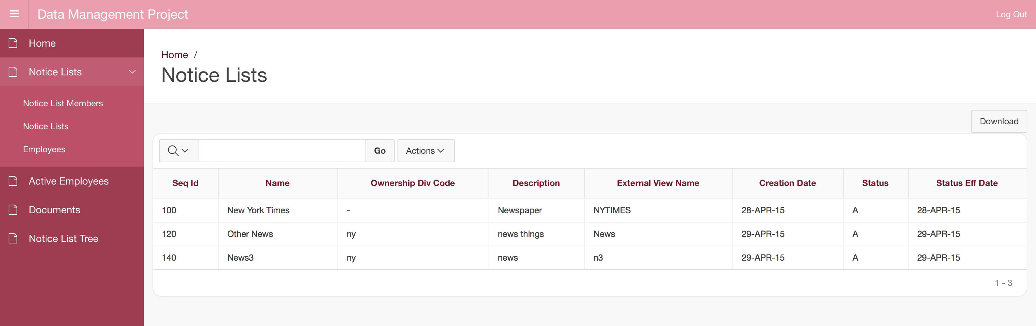
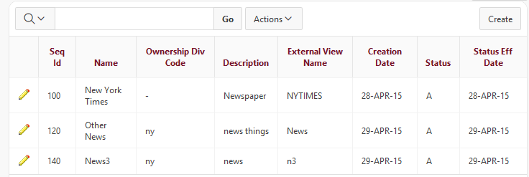
Notice Lists

Slide 7
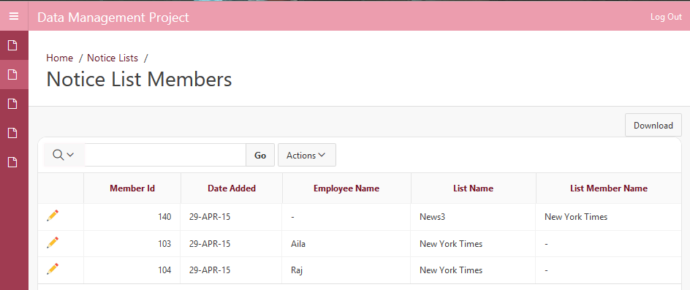
Notice List Members

Slide 8
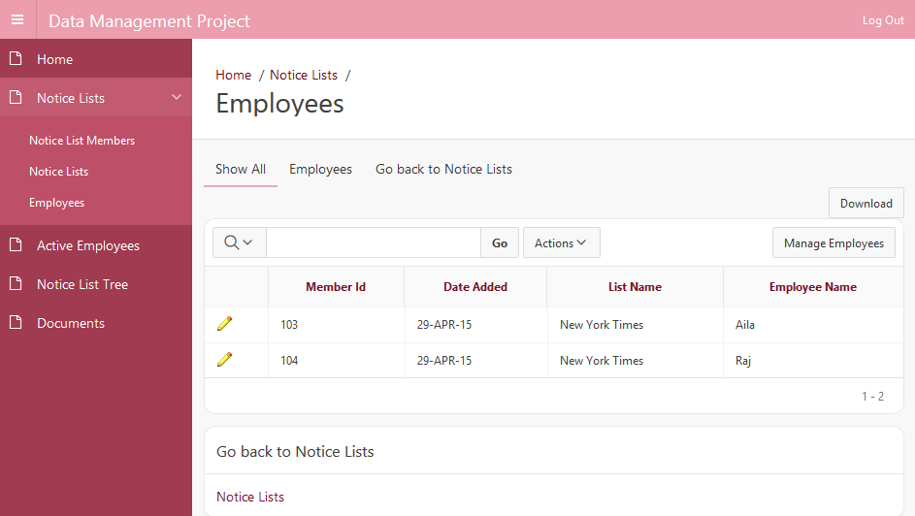
NL Members – Employees

Slide 9
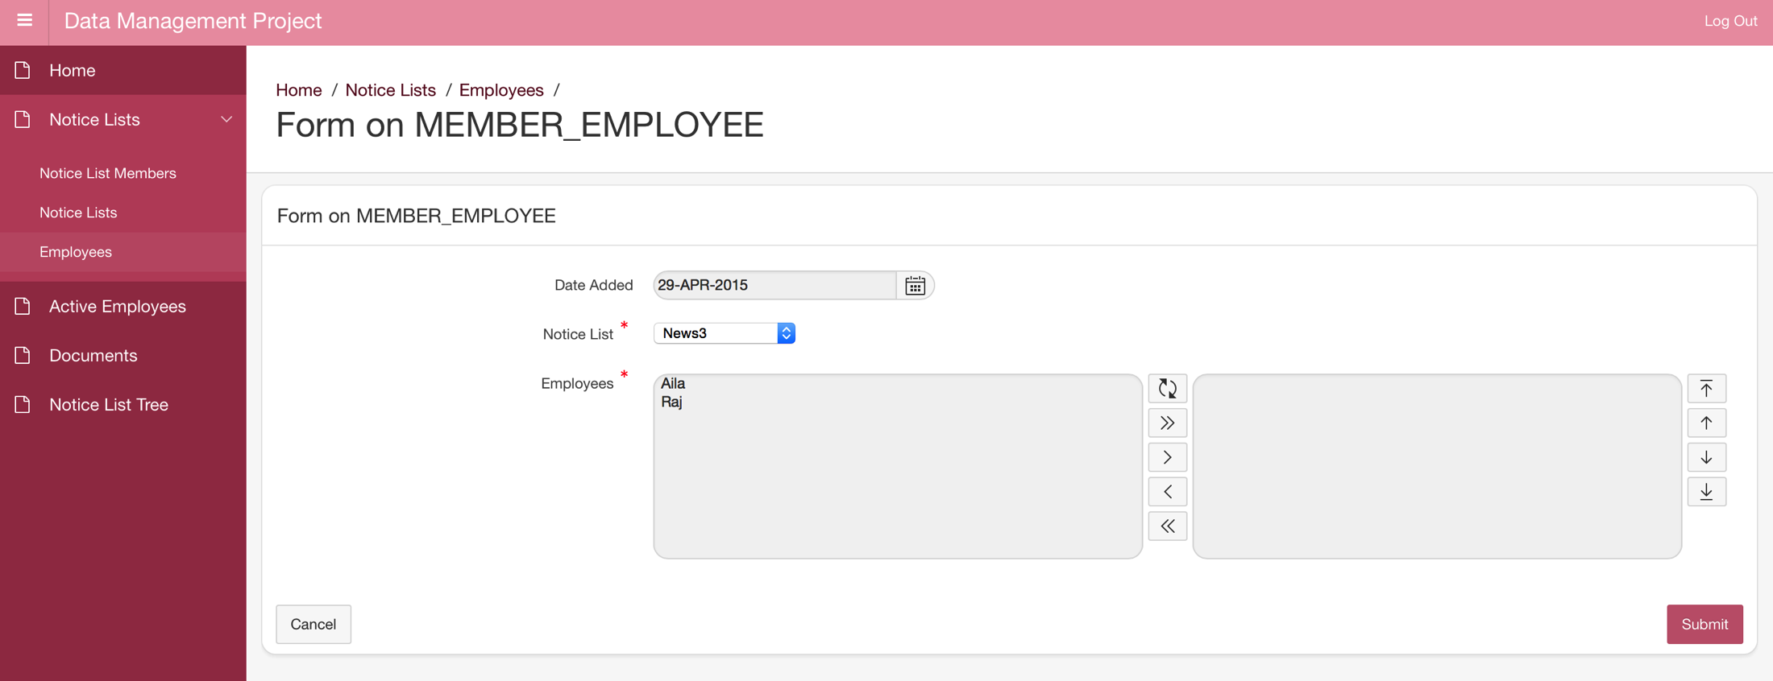
Adding Employees to a Notice List

Slide 10
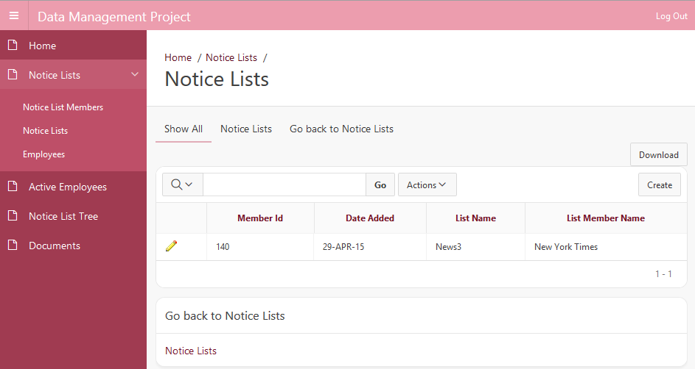
NL Members – Notice Lists

Slide 11
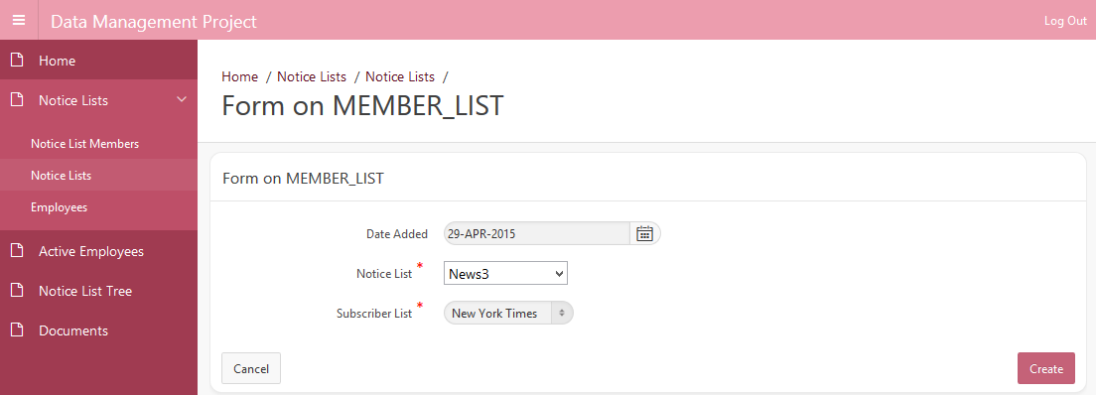
Adding Notice Lists to a Notice List

Slide 12
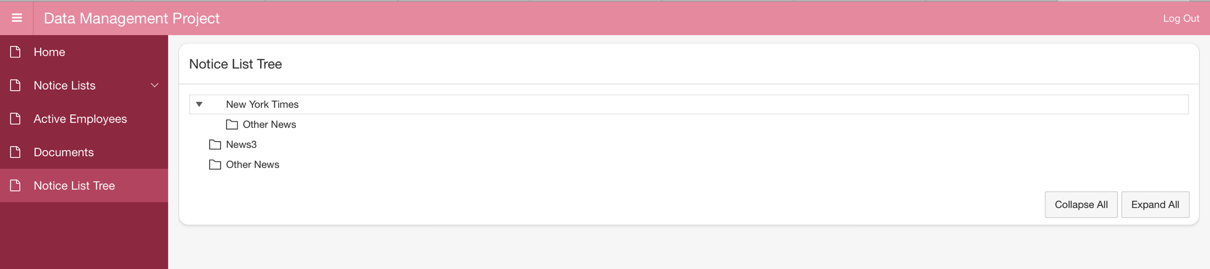
Tree

Slide 13
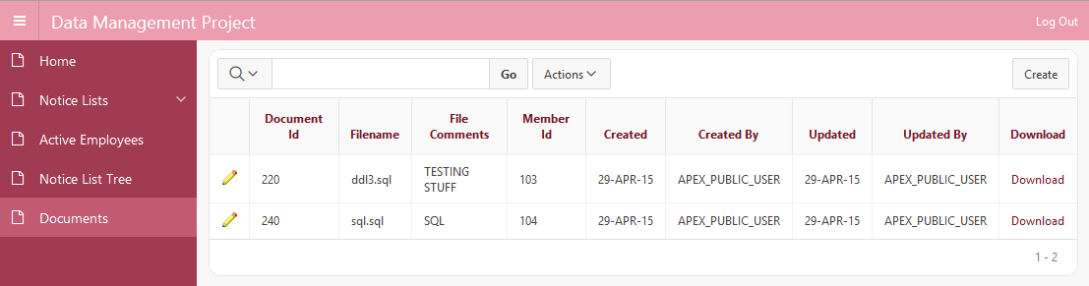
Documents

Slide 14
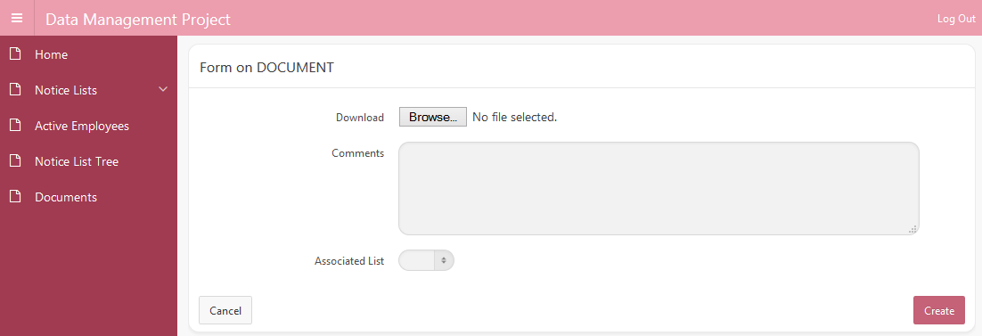
Creating Docs

Slide 15
Apex URL
Apex URL

